Slide 1
Data Mining Assignment 1
Team Data Miners
Emma Focht, Nhi Tran, Nicole Ihlenfield, Dylan Curran, Nicholas Kemper

Slide 2
Overview of Data: IMDB Movie DataSet
This dataset looks at several points of both numeric and categorical data collected on over 5,000 movies listed on IMDB.
Here are a few examples of variables collected on each movie:
Director Name
Movie Title
Facebook likes of leading actors/actresses
Number of critic reviews
Year of release
Aspect Ratio
IMDB Score
Budget

Slide 3
Summary Statistics
# of critic reviews
Min. :1.0
1st Qu. :50.0
Median :110.0
Mean :140.2
3rd Qu. :195.0
Max. :813.0
NA's :50
Duration
Min. :7.0
1st Qu. :93.0
Median :103.0
Mean :107.2
3rd Qu. :118.0
Max. :511.0
NA's :15
Director Facebook Likes
Min. :0.0
1st Qu. :7.0
Median :49.0
Mean :686.5
3rd Qu. :194.5
Max. :23000.0
NA's :104
Actor_3 Facebook Likes
Min. :0.0
1st Qu. :133.0
Median :371.5
Mean :645.0
3rd Qu. :636.0
Max. :23000.0
NA's :23

Slide 4
Summary Statistics
Actor_1 Facebook Likes
Min. :0
1st Qu. :614
Median :988
Mean :6560
3rd Qu. :11000
Max. :640000
NA's :7
Gross
Min. :162
1st Qu. :5340988
Median :25517500
Mean :48468408
3rd Qu. :62309438
Max. :760505847
NA's :884
# of Voted Users
Min. :5
1st Qu. :8594
Median :34359
Mean :83668
3rd Qu. :96309
Max. :1689764
Cast Total Facebook Likes
Min. :0
1st Qu. :1411
Median :3090
Mean :9699
3rd Qu. :13756
Max. :656730

Slide 5
Summary Statistics
Faces in Poster
Min. :0
1st Qu. :0
Median :1
Mean :1.371
3rd Qu. :2
Max. :43
NA's :13
# of Users for Reviews
Min. :1.0
1st Qu. :65.0
Median :156.0
Mean :272.8
3rd Qu. :326.0
Max. :5060.0
NA's :21
Budget
Min. :2.180e+02
1st Qu. :6.000e+06
Median :2.000e+07
Mean :3.975e+07
3rd Qu. :4.500e+07
Max. :1.222e+10
NA's :492
Title Year
Min. :1916
1st Qu. :1999
Median :2005
Mean :2002
3rd Qu. :2011
Max. :2016
NA's :108

Slide 6
Summary Statistics
Actor_2 Facebook Likes
Min. :0
1st Qu. :281
Median :595
Mean :1652
3rd Qu. :918
Max. :137000
NA's :13
Movie Facebook Likes
Min. :0
1st Qu. :0
Median :166
Mean :7526
3rd Qu. :3000
Max. :349000
NA's :15
IMDB Scores
Min. :1.600
1st Qu. :5.800
Median :6.600
Mean :6.442
3rd Qu. :7.200
Max. :9.500
Aspect Ratio
Min. :1.18
1st Qu. :1.85
Median :2.35
Mean :2.22
3rd Qu. :2.35
Max. :16.00
NA's :329

Slide 7
Summary Statistics
Summary
Numeric variables that have missing data and should be handled by deleting records or imputing medians : # of critic reviews, duration, director Facebook likes, actors #3 Facebook likes, actor #1 Facebook likes, gross, budget, title year, faces in poster, # of users for reviews, aspect ratio, actor #2 Facebook likes, movie Facebook likes.
These variables are likely to normally distributed (mean ~ median): duration, title year, IMDB scores.

Slide 8
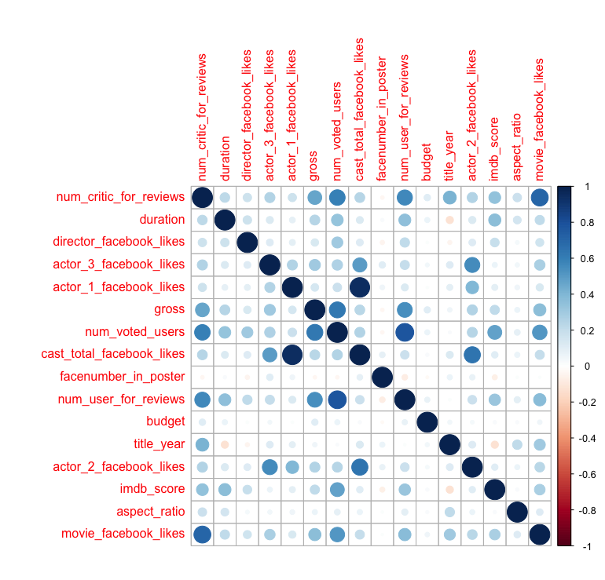
Correlation with Heatmap
Summary
There are a number of correlated variables in this dataset:
Facebook likes and number are highly correlated, movies might be more likely to be reviewed if popular on Facebook.
The total cast facebook likes is correlated to the actor 1 facebook likes, this makes sense as actor likes are factored into the total likes.
One interesting feature is that budget is not correlated to any variable, so budget is not a well predictor for a “good” IMDB score or gross.

Slide 9
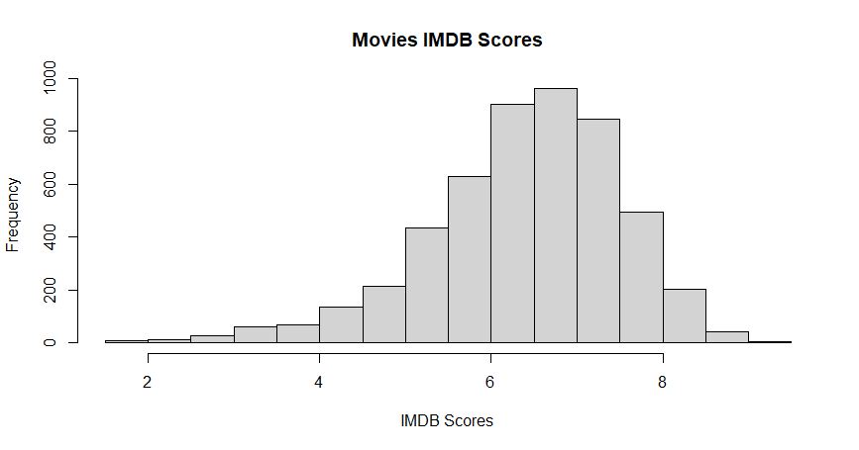
Histogram
Summary
Mean of IMDB scores is 6.4.
Quantiles:
This shows it is unlikely for a movie to score less than a 5.5 IMDB score.
25% | 50% | 75%
5.8 | 6.6 | 7.2
Notes:
imdbmovie <- read.csv("IMDB_Movie_Dataset")
hist(IMDB_Movie_Dataset$imdb_score, main = "Total Count of IMDB Scores", xlab = "IMDB Score")
mean(IMDB_Movie_Dataset$imdb_score)
median(IMDB_Movie_Dataset$imdb_score)
mode(IMDB_Movie_Dataset$imdb_score)
quantile(IMDB_Movie_Dataset$imdb_score, c(.25,.5,.75), type = 1)

Slide 10
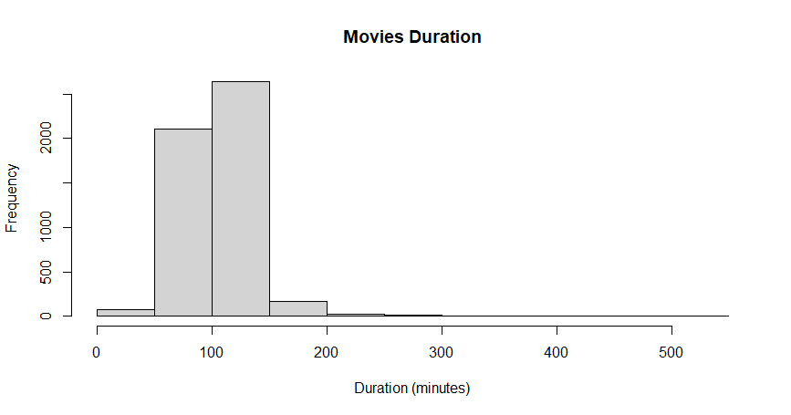
Histogram
Summary
Most movies have duration between 50-150 minutes.
The average duration is 107.2.
The median duration is 103.0.

Slide 11
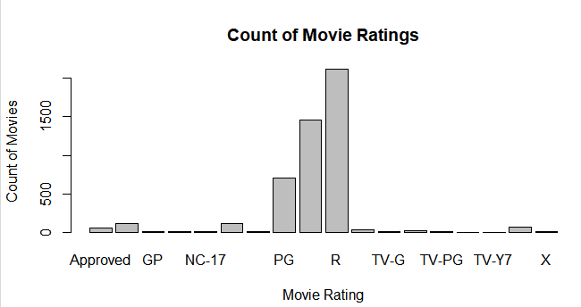
Bar Chart
Summary
Most movies in our dataset fall in the PG, PG-13 and R ratings.
There are more R rated movies in our set than any other type of movies.
Notes:
ratingcount <- table(IMDB_Movie_Dataset$content_rating)
barplot(ratingcount, xlab = "Movie Rating", ylab = "Count of Movies", main ="Count of Movie Ratings")

Slide 12
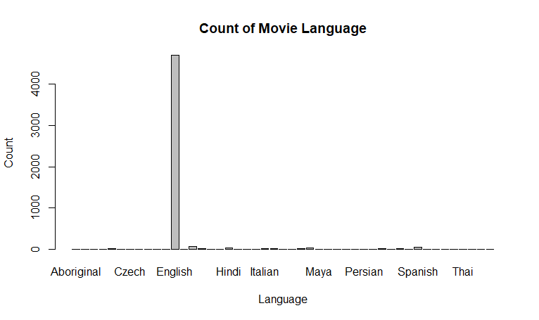
Bar Chart
Summary
Most movies in the dataset (approximately 95%) are in English.

Slide 13
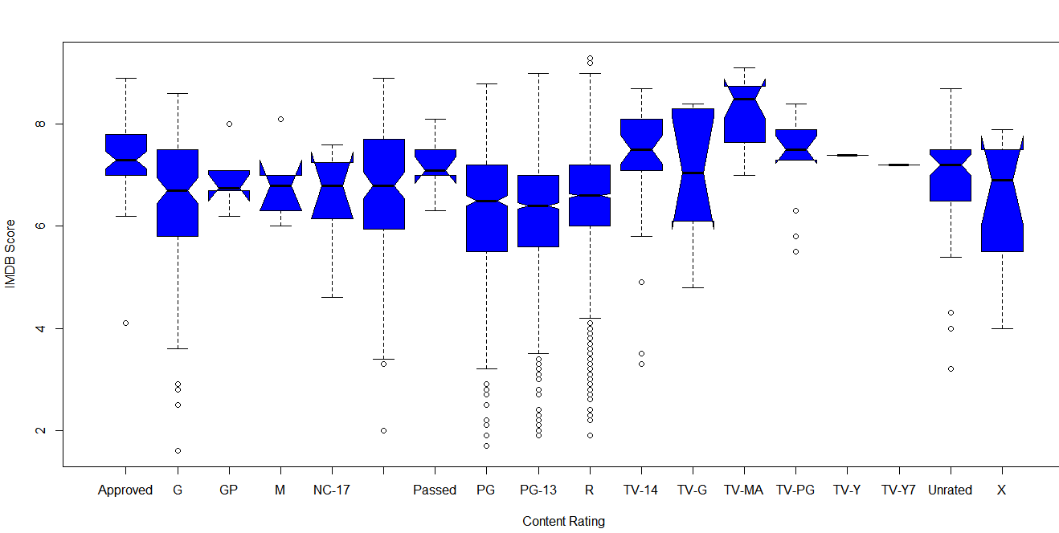
Box Plot
Summary
This shows the mean IMDB scores of movies based on their content ratings.
TV-MA content ratings tend to have a slightly higher mean IMDB scores than other ratings.
Notes:
boxplot(IMDB_Movie_Dataset$imdb_score ~ IMDB_Movie_Dataset$content_rating, xlab = "Content Rating", ylab = "IMDB Score",notch = TRUE)

Slide 14
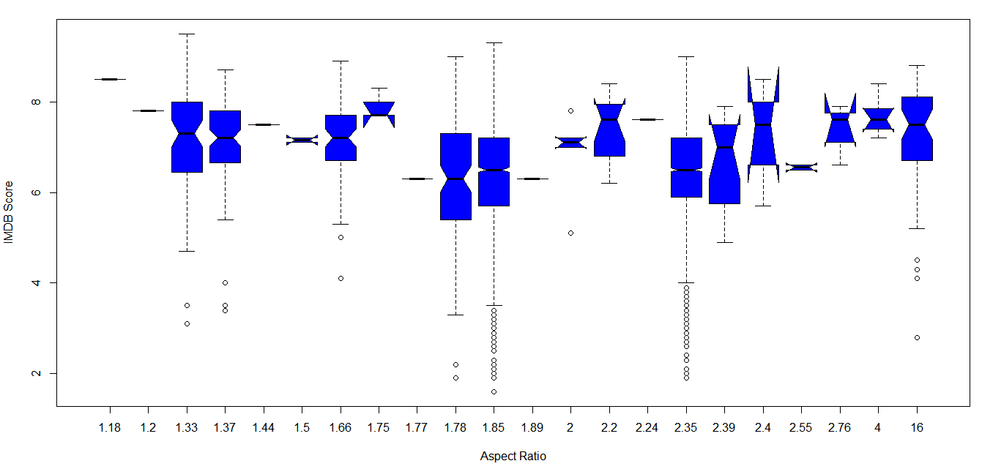
Box Plot
Summary
This looks at average IMDB scores compared to Aspect Ratio.
There is almost no relationship between how well a movie is rated on IMDB and its aspect ratio.

Slide 15
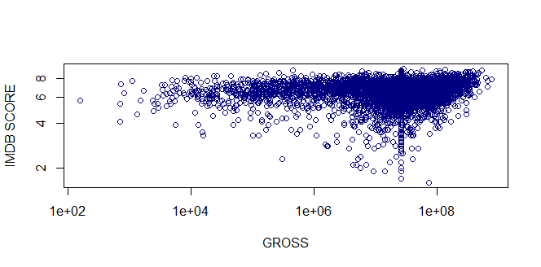
Scatterplot
Summary
Looking at the scatterplot, there appears to be not much correlation between gross and IMDB Score with the exception of a couple outliers.
Most films receive a score of 5 or higher.
Note: Missing data have been replaced by the median of the data set for each variable.
Scatterplot of IMDB Score vs. Gross
Notes:
plot(IMDB.df$imdb_score~IMDB.df$gross, xlab= "GROSS", ylab = "IMDB SCORE", log='xy',col="navyblue")

Slide 16
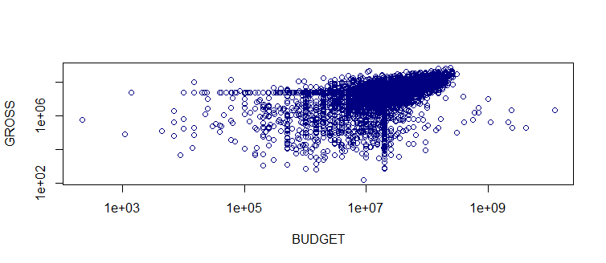
Scatterplot
Summary
Similar to the previous scatterplot, there appears to be a bit of a positive correlation between gross and budget (the more you spend, the more you earn) with the exception of a couple outliers.
Note: Missing data have been replaced by the median of the data set for each variable.
Scatterplot of Gross vs. Budget
Notes:
plot(IMDB.df$gross~IMDB.df$budget,xlab="BUDGET", ylab= "GROSS",log='xy', col="navyblue")

Slide 17
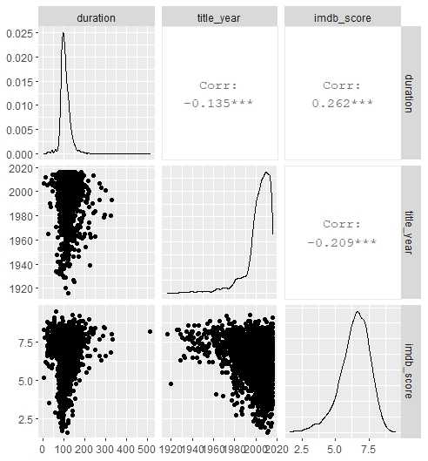
Scatterplot Matrix
Summary
There is not a whole lot of correlation between any of the variables.
There is slightly negative correlation between title_year and duration and title_year and imdb_score.
There is slightly positive correlation between imdb_score and duration.
However, this isn’t enough of a correlation to conclude that these variables have any significant correlation.
Notes:
library(GGally)
ggpairs(IMDB.df[, c(4, 24, 26)])

Slide 18
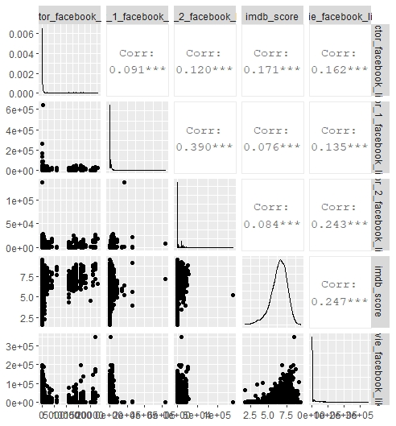
Scatterplot Matrix
Summary
Comparing Facebook reviews with number of likes per actor and for the movie, there is only a very slight positive correlation between them and the IMDB score.
As you can see, you can’t conclude that Facebook likes is correlated with the IMDB score.
Notes:
library(GGally)
ggpairs(IMDB.df[, c(5, 8, 25, 26, 28)])

Slide 19
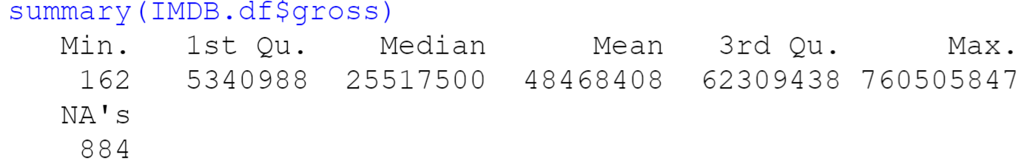
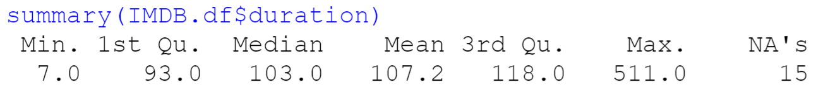
Handling Missing Data
In order to find the missing data, each numeric variable must be checked using the following function:
(Note: change the variable as needed)
After finding the missing data (NA), note how much is missing to determine whether deleting the data or replacing it is the best option. Variables with less than 100 missing are fine to remove, but anything higher should be replaced with the median of the data set for that variable.
Notes:
summary(IMDB.df$num_critic_for_reviews)
IMDB.df <- IMDB.df[!is.na(IMDB.df$num_critic_for_reviews),]
dim(IMDB.df)
summary(IMDB.df$duration)
IMDB.df <- IMDB.df[!is.na(IMDB.df$duration),]
summary(IMDB.df$director_facebook_likes)
IMDB.df$director_facebook_likes[is.na(IMDB.df$director_facebook_likes)] <- median(IMDB.df$director_facebook_likes, na.rm = TRUE)
summary(IMDB.df$director_facebook_likes)
summary(IMDB.df$actor_3_facebook_likes)
IMDB.df <- IMDB.df[!is.na(IMDB.df$actor_3_facebook_likes),]
summary(IMDB.df$actor_1_facebook_likes)
IMDB.df <- IMDB.df[!is.na(IMDB.df$actor_1_facebook_likes),]
summary(IMDB.df$gross)
IMDB.df$gross[is.na(IMDB.df$gross)] <- median(IMDB.df$gross, na.rm = TRUE)
summary(IMDB.df$gross)
summary(IMDB.df$budget)
IMDB.df$budget[is.na(IMDB.df$budget)] <- median(IMDB.df$budget, na.rm = TRUE)
summary(IMDB.df$budget)
summary(IMDB.df$aspect_ratio)
IMDB.df$aspect_ratio[is.na(IMDB.df$aspect_ratio)] <- median(IMDB.df$aspect_ratio, na.rm = TRUE)
summary(IMDB.df$aspect_ratio)
summary(IMDB.df$facenumber_in_poster)
IMDB.df <- IMDB.df[!is.na(IMDB.df$facenumber_in_poster),]
dim(IMDB.df)

Slide 20
Handling Missing Data
For each of the variables that were missing less than 100 data, the following function was used to remove them:
(Note: change the variable as needed)
For each of the variables that were missing more than 100, the following function was used to replace it with the median value of the data set:
(Note: change the variable as needed)

Slide 21
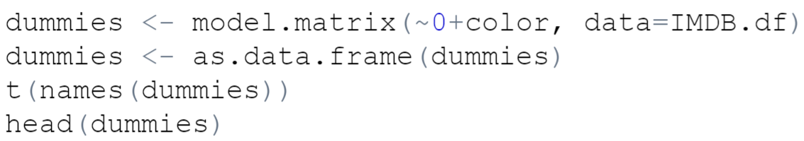
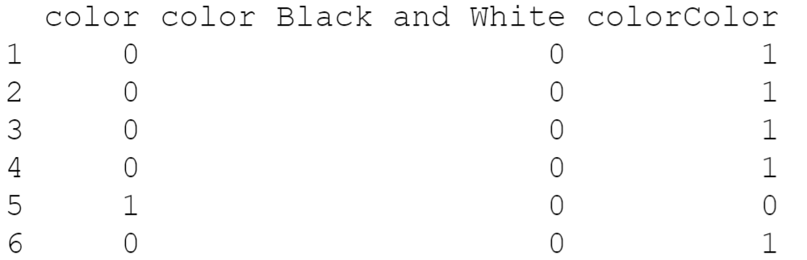
Converting Categorical Variables
In order to convert one of the categorical variables into dummy variables the following code was used. The categorical variable that was converted was “color” which indicates whether the film was in color or black and white.
Because there are some missing
variables, we must drop the dummy
variable “color.”
Notes:
dummies <- model.matrix(~0+color, data=IMDB.df)
dummies <- as.data.frame(dummies)
t(names(dummies))
head(dummies)
dummies <- dummies[,-1]
IMDB.df <- cbind(IMDB.df[,-c(1)], dummies)

Slide 22
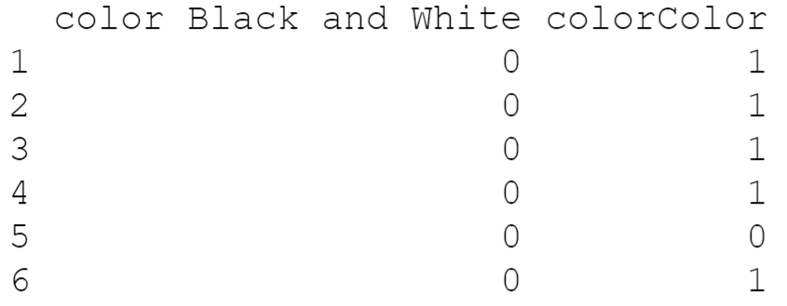
Converting Categorical Variables
The following function was used to drop the “color” variable as it counted for missing values.
After removing the variable, the
dummies must be included back into
the data set by using the following
code. This code also removes the
variable that was missing earlier.

Slide 23
Conclusions
Some points to consider while exploring the dataset to use the dataset to predict IMDB Score:
Around 70% of movies score above 6.
There are irrelevant variables as we predict IMDB Scores, therefore, should be removed (e.g., language - English takes up around 95% of records, number of faces in poster - weak correlation with IMDB score).
IMDB score is not strongly correlated with any numeric variable (slightly correlated with number of voted users).

